Slide 1
Syed Sahil A
Final Project
3/21/2024 Annual Review

Slide 2
CIFAR-10 Object Recognition using ResNet50
3/21/2024 Annual Review

Slide 3


AGENDA
Data Preprocessing: Prepare the CIFAR-10 dataset for training.
Model Architecture: Implement ResNet50 neural network.
Training: Train ResNet50 on the CIFAR-10 dataset.
Evaluation: Assess model performance using test data.
Fine-tuning (optional): Adjust hyperparameters for optimization.
Deployment: Deploy the trained model for real-world applications.
3/21/2024 Annual Review

Slide 4

PROBLEM STATEMENT
To develop a deep learning model capable of accurately classifying 32x32 color images from the CIFAR-10 dataset into one of ten predefined categories. This involves addressing challenges such as limited image resolution, variations in object appearance, and the need for efficient training to achieve high classification accuracy.
3/21/2024 Annual Review

Slide 5

PROJECT OVERVIEW
The project aims to implement CIFAR-10 Object Recognition using ResNet50, a deep learning approach for classifying 32x32 color images into ten categories. It involves dataset preparation, ResNet50 architecture implementation, model training, evaluation, and possibly fine-tuning for optimal performance. The project's goal is to develop a robust model capable of accurately identifying objects in images, serving as a benchmark for image recognition tasks.
3/21/2024 Annual Review

Slide 6

WHO ARE THE END USERS?
Researchers: Utilize the trained model for benchmarking and comparison with other image recognition techniques.
Developers: Integrate the model into applications for image classification tasks, such as content moderation, image search, and object detection.
Educators: Use the project as a learning resource for teaching deep learning concepts, image classification techniques, and model deployment.
Enthusiasts: Experiment with the model, explore its capabilities, and learn about image recognition technology through hands-on projects and demonstrations.
3/21/2024 Annual Review

Slide 7

YOUR SOLUTION AND ITS VALUE PROPOSITION
I offer a comprehensive implementation of CIFAR-10 Object Recognition using ResNet50, providing a well-documented codebase and detailed instructions for usage and customization.
High Accuracy: Leveraging ResNet50, renowned for its effectiveness in image recognition, ensures precise classification.
Efficiency: Utilize pre-trained ResNet50 weights, reducing training time and computational requirements.
Flexibility: Customizable for specific needs, such as adjusting hyperparameters and integrating additional techniques.
Educational Resource: A valuable learning tool for researchers, developers, educators, and enthusiasts interested in image recognition.
Benchmarking: Serve as a benchmark for evaluating and comparing different approaches to CIFAR-10 object recognition, fostering further innovation in computer vision.
3/21/2024 Annual Review

Slide 8

THE WOW IN YOUR SOLUTION
Breakthrough Accuracy: Harnessing ResNet50's cutting-edge architecture ensures unparalleled precision in image classification.
Lightning Speed: By leveraging pre-trained ResNet50 weights, our solution slashes training time, maximizing efficiency without compromising accuracy.
Tailored Precision: Our customizable approach allows fine-tuning to meet specific project requirements, providing a bespoke solution for every need.
Empowering Education: Serving as both a tool and a teacher, our solution empowers learners of all levels to delve into the fascinating world of image recognition.
Setting the Standard: As a benchmark in CIFAR-10 object recognition, our solution not only excels but also inspires further advancements in computer vision.
3/21/2024 Annual Review
8

Slide 9
MODELLING
Data Preprocessing: Normalize pixel values and apply data augmentation techniques.
Model Architecture: Implement ResNet50 with convolutional layers and global average pooling.
Training: Split dataset, train using SGD with momentum, and monitor performance on validation set.
Evaluation: Assess model on test set, calculate metrics, and visualize performance.
Fine-tuning: Adjust hyperparameters and optimization algorithms if needed.
Deployment: Integrate model into production environments for real-time object recognition.
3/21/2024 Annual Review
9

Slide 10
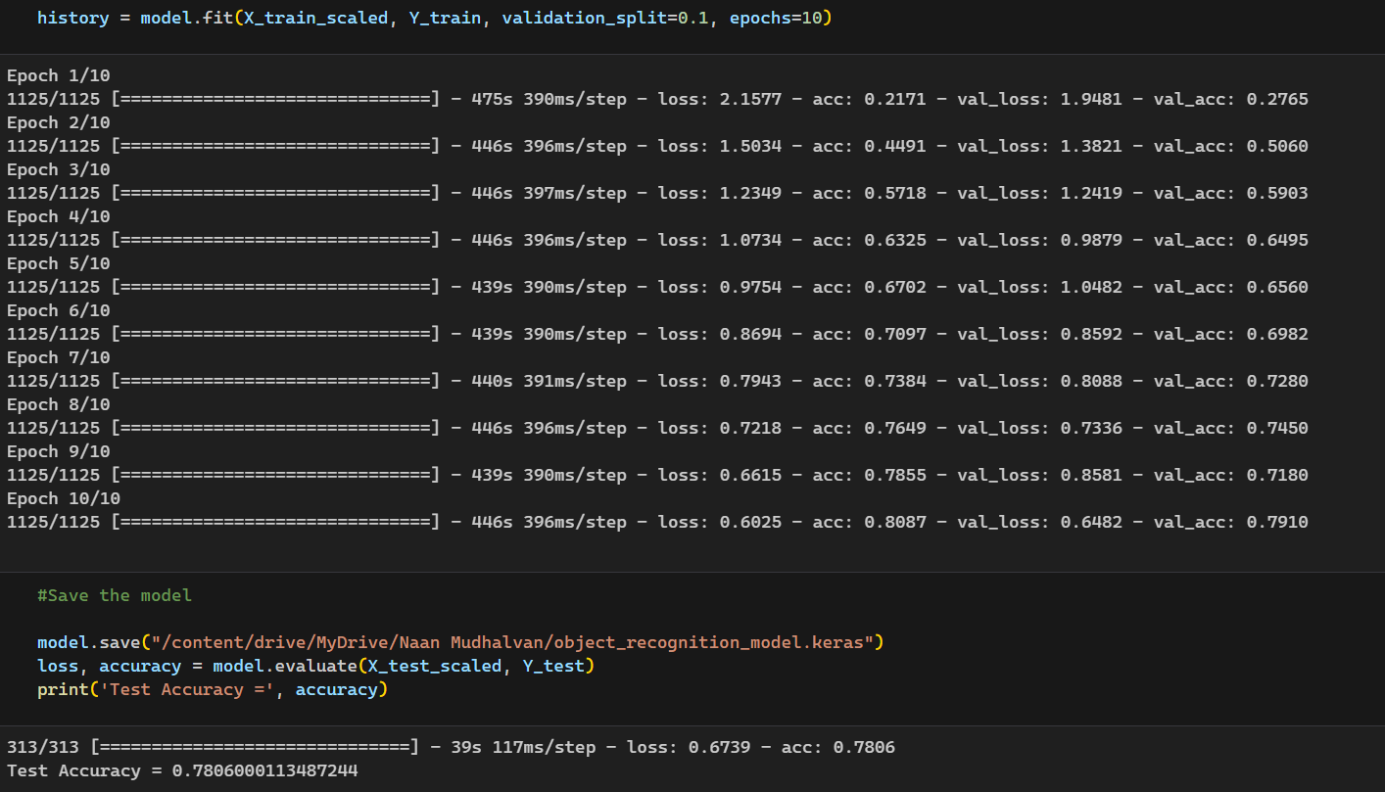
RESULTS (TRAINING)
Demo Link
3/21/2024 Annual Review
10

Slide 11
RESULTS (ACCURACY)
Demo Link
3/21/2024 Annual Review
11

Slide 12
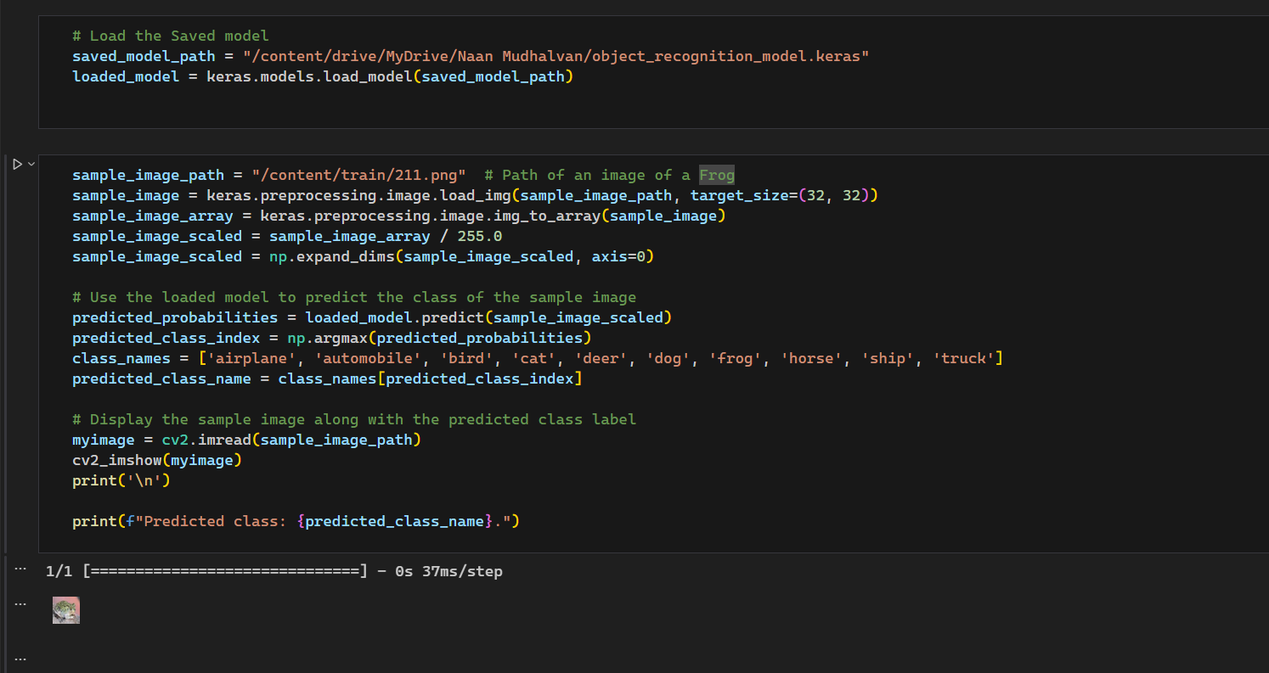
RESULTS (PREDICTION)
Demo Link
3/21/2024 Annual Review
12

